Slide 1

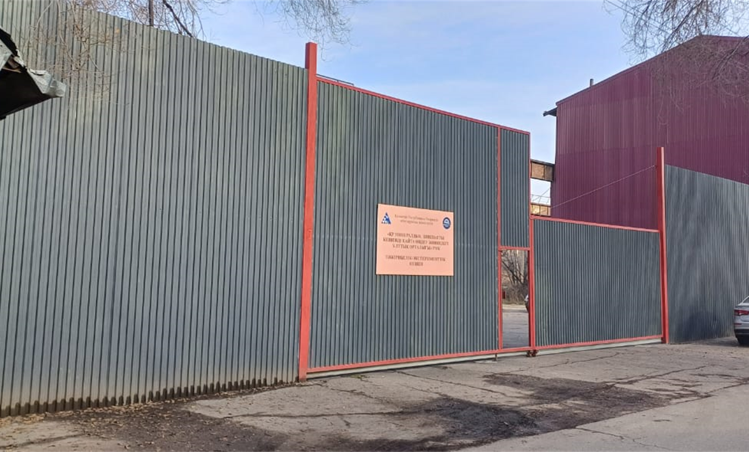
Republican State Enterprise “National Center for Complex
of Mineral Raw Materials”
Experimental and Research Complex (ERC)
The ERC is an integral part of the ecosystem for the comprehensive processing of mineral raw materials in the Republic of Kazakhstan.
With Research and Development, multipurpose innovative production, and its convenient location within an industrial cluster with access to automobile and railway networks, as well as other logistical infrastructures, the ERC is poised to become one of the leading experimental scientific-industrial hubs in Almaty.
Site Infrastructure:
Existing buildings and structures with corridors for engineering communications
Access roads to neighboring industrial sites
Enclosed territory with a concrete fence and multiple vehicle entry points.

Slide 2
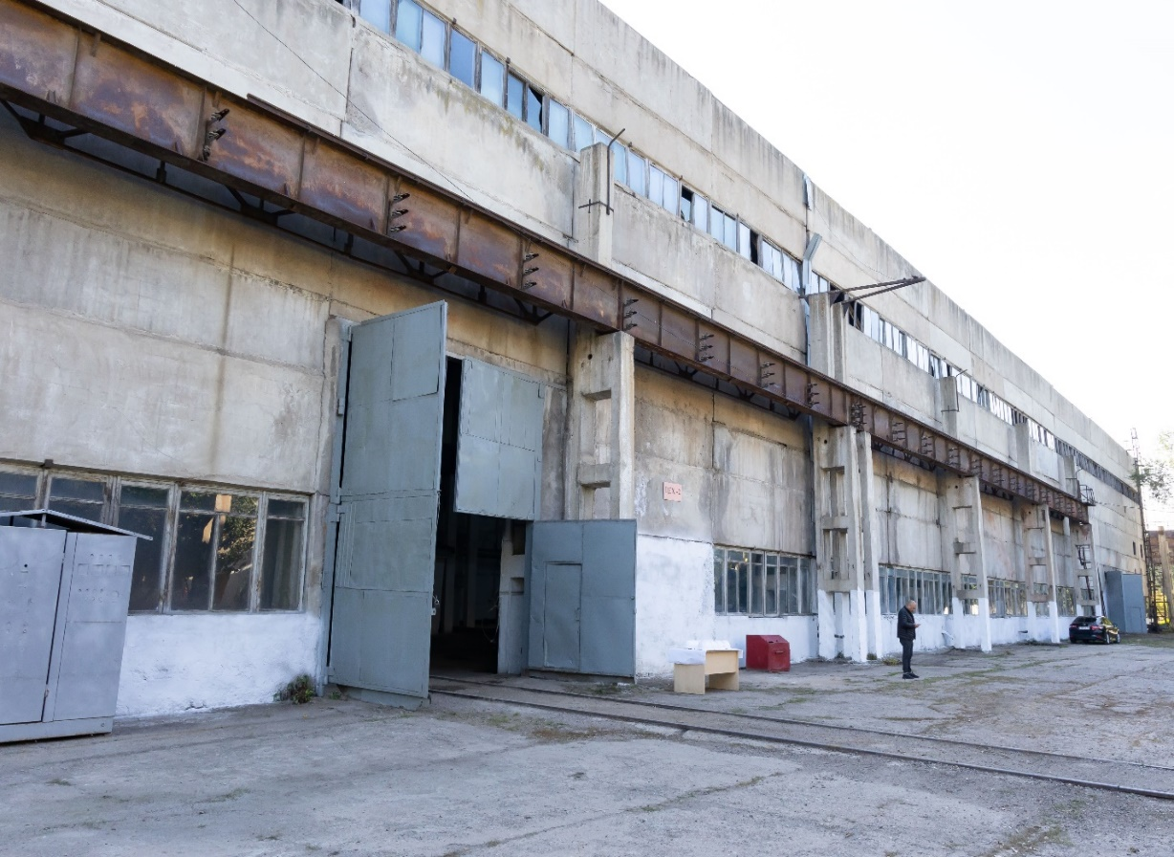
Overview
Location Details:
City: Almaty
District: Turksib
Address: Krasnogorskaya Street, 71
Number of Floors: 1
Railway Spur: 2,378 meters
Wall Material: Reinforced concrete panels
Year Built: 1976
Land Use Designation: Operation and maintenance of administrative and industrial buildings
The ERC currently operates three production workshops,
including an innovative line for producing multi-functional silicon-carbon material.
Planned Expansion:
Launch and maintenance of an innovative gas block production line.

Slide 3
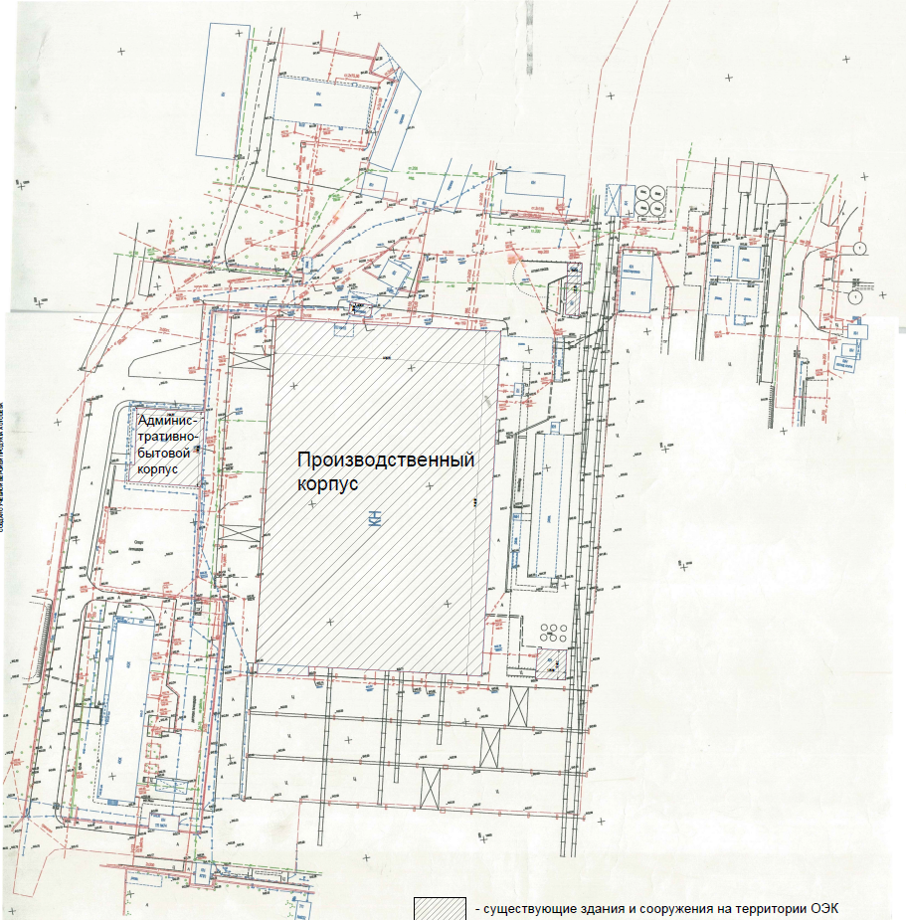

Completed engineering and geodetic surveys at a 1:1000 scale.
Total area within boundaries of the plot | 40,000 m²
Developed area | 14,700 m²
Including railway spur | 200 m
ERC construction area | 13,700 m²
Building volume | 60,251 m³
Administrative and residential block | 2,355 m²
Landscaping/green area | 3,000 m²
Construction density | 60%
Administrative and Residential Building
Production Building
- existing buildings and structures on the ERC territory

Slide 4
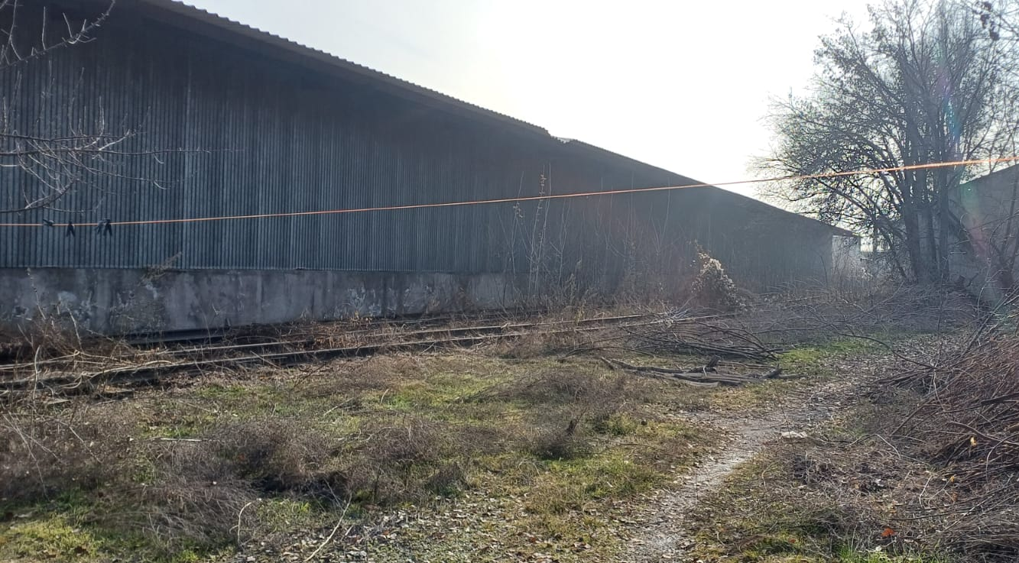
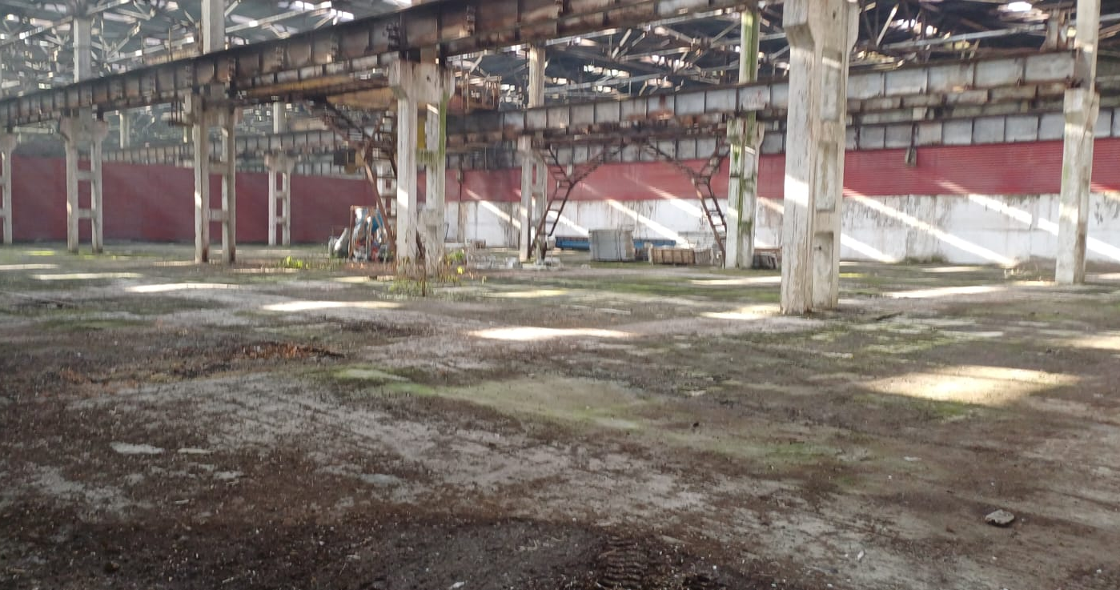
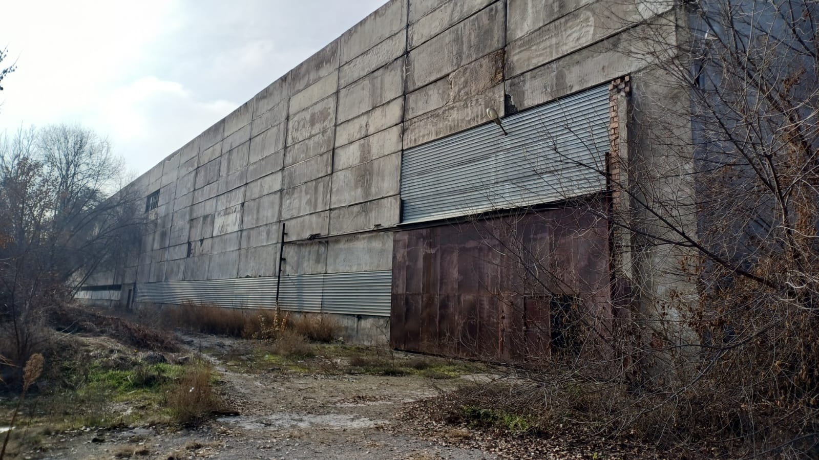
Environmental Parameters:
Warm Period: Outdoor temperature 𝑡_{avg}=+26.4°𝐶;
Cold Period: Outdoor temperature 𝑡_{avg}=−10.2°𝐶
Average temperature during the heating period: 𝑡_{avg}=−2.5°𝐶
Heating duration: 135 days

Slide 5
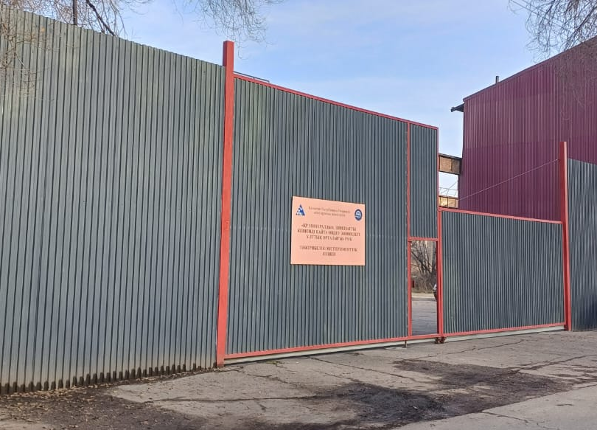
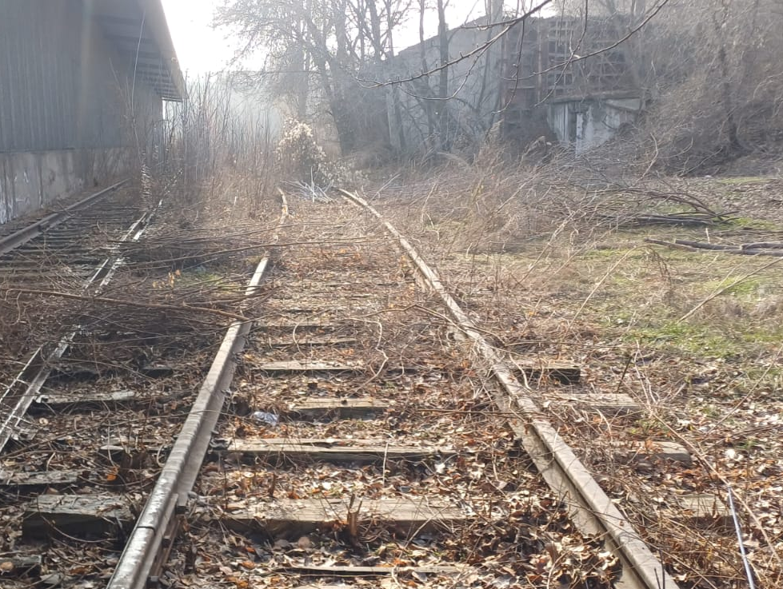
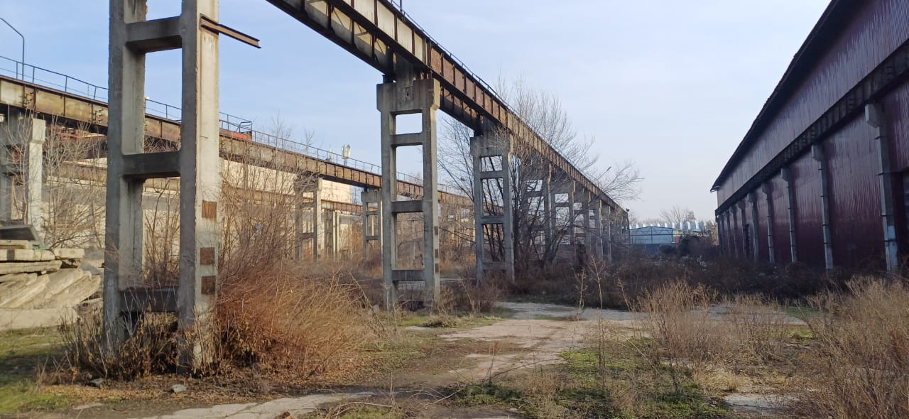
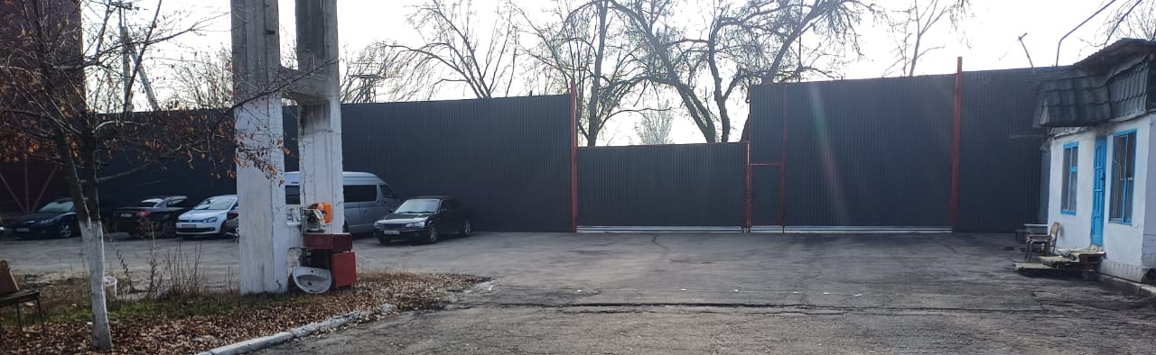

Slide 6
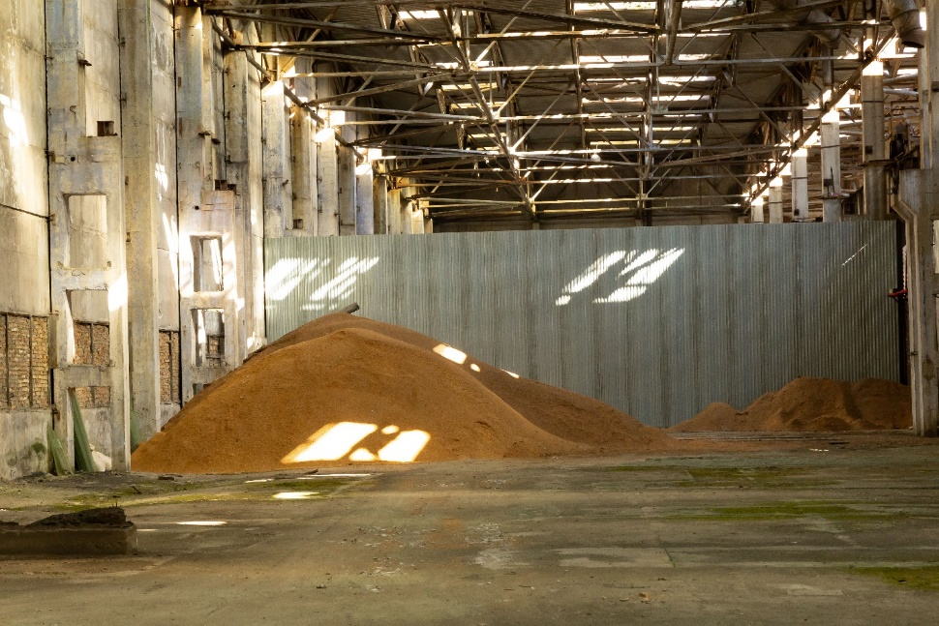
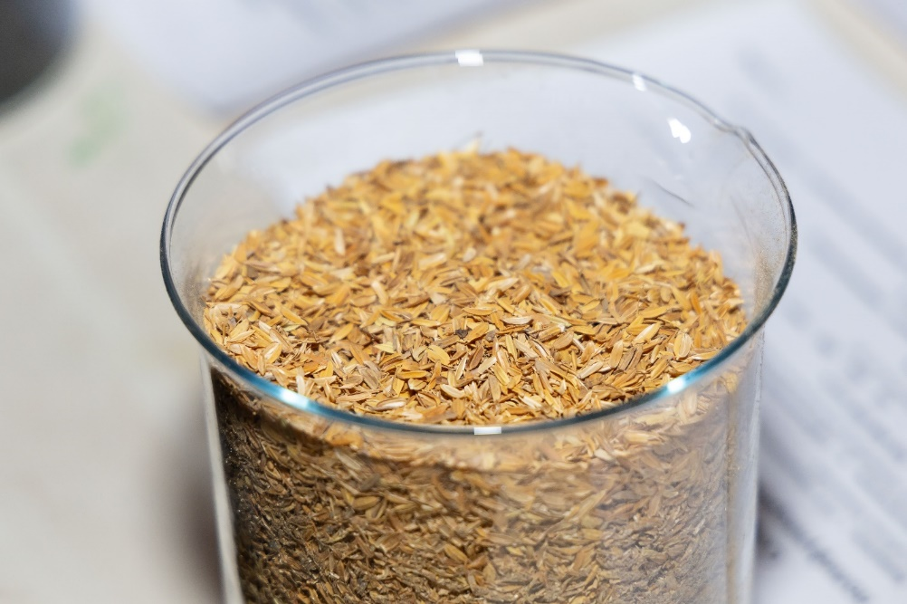
Silicon-Carbon Material Production
Technology and Raw Material Use:
The ERC has implemented a processing unit for rice husks, funded through commercialization projects under the "Science Fund" program.
Unique eco-friendly composite material combining silicon and carbon, derived from rice husks.
The only known technology in the world to produce multifunctional silicon-carbon nanocomposites from rice husks.
Significance of Rice Husks:
Comprise ~20% of rice mass, generating tens of millions of tons of waste annually.
Unlike other plant materials, rice husks do not decompose in soil or serve as animal feed.
Rich in silica (silicon dioxide), making them a valuable renewable metallurgical raw material.

Slide 7
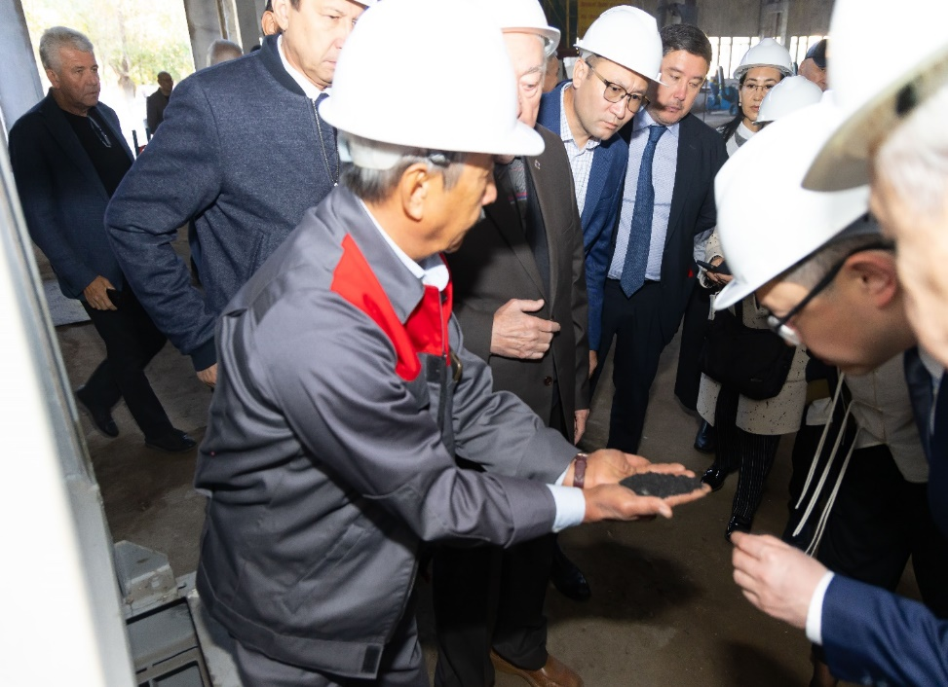
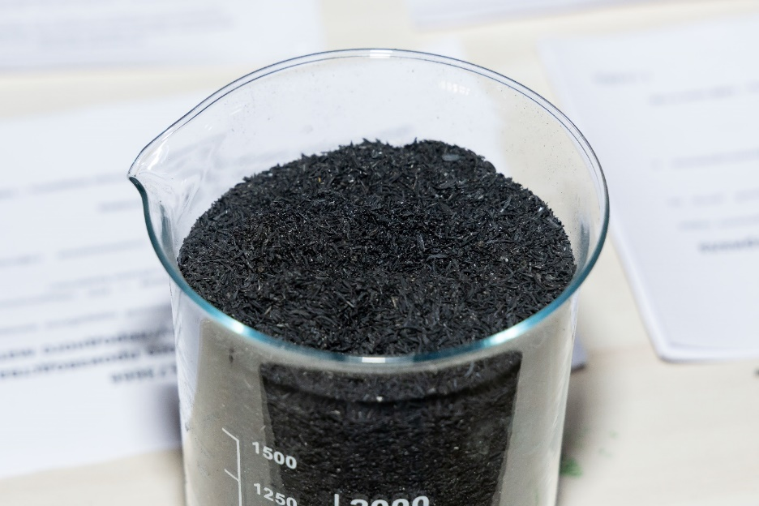
Silicon-Carbon Composition:
Silicon-carbon contains 50% C, 40% SiO₂, 10% hydrocarbons
Its bulk density, kg/m³:
Granules – 90-110
Powder – 360-420
Competitive advantage: the price is 1.5–2 times lower than analogs (technical carbon, white soot, and silicon-carbon-based feed additives such as Etakal). It is produced from agricultural waste.
The availability of raw materials allows for an annual production of 20,000 tons of silicon-carbon, fulfilling domestic demand and allowing for export.

Slide 8
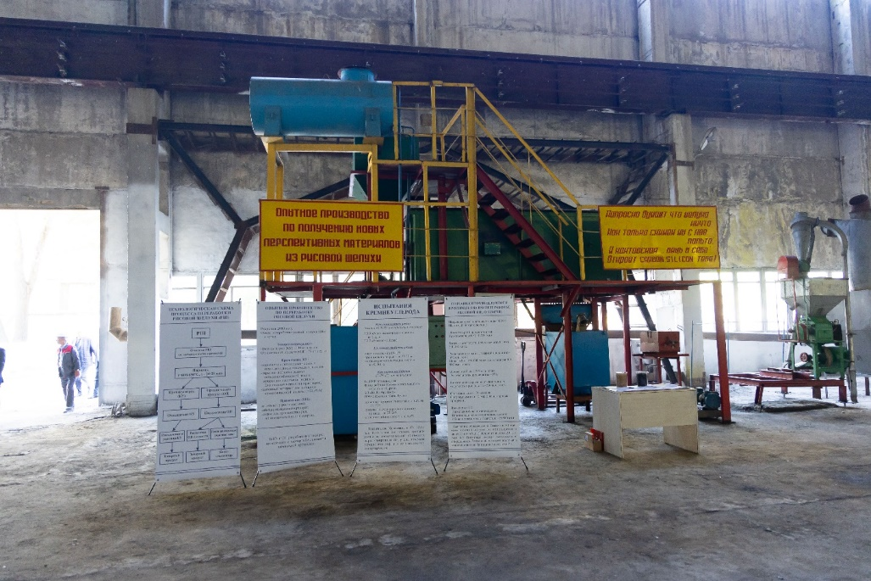
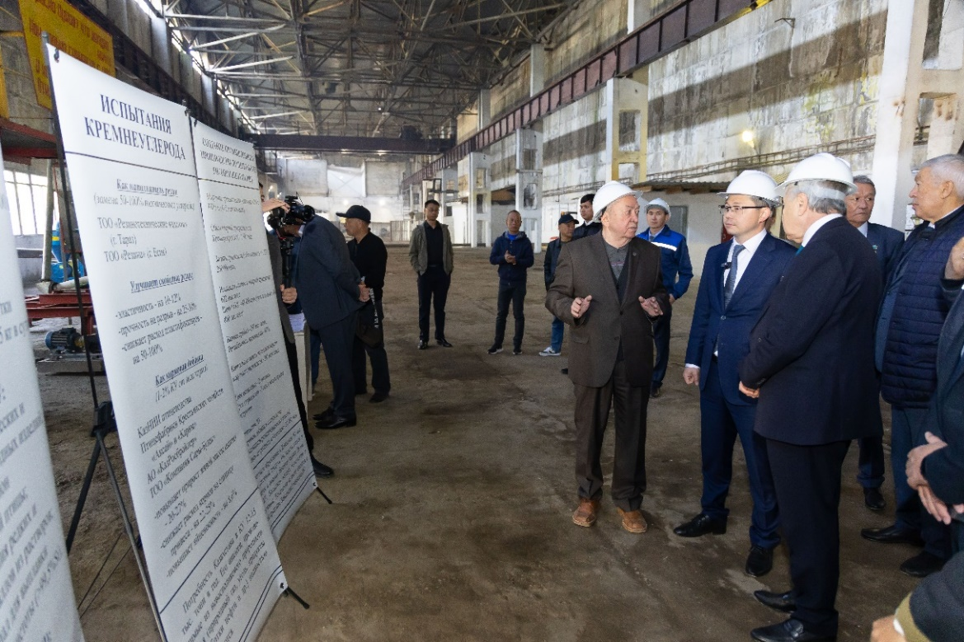
Applications of Silicon-Carbon Material
In Rubber Production:
  Improves product elasticity and strength by 10-15%.
  Reduces production costs by 10%.
  Tested at TОО "Rubber Products" and TОО "Rubber."
In Aircraft Brake Systems:
  Enhances physical and tribological properties by 10-20%.
  Reduces linear wear by 20-25%.
  Shortens braking distance in humid environments by 50%.
  Tested at ZAO "Promtekhnika."
As an Animal Feed Additive:
Non-toxic material, rich in carbon and silicon dioxide.
Can be used as a biologically active component in livestock and poultry feed.

Slide 9
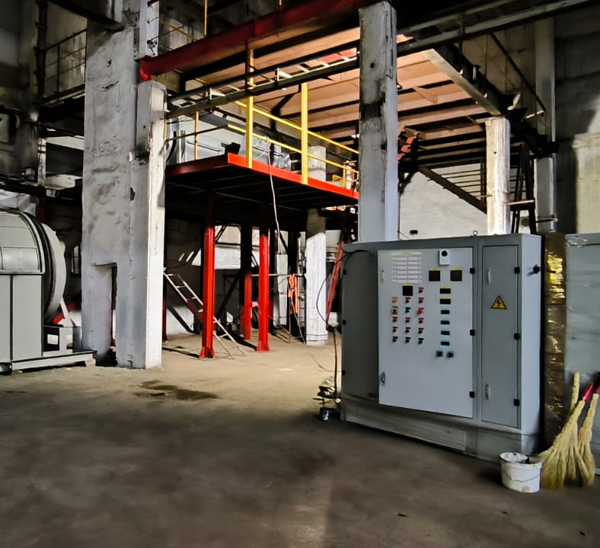
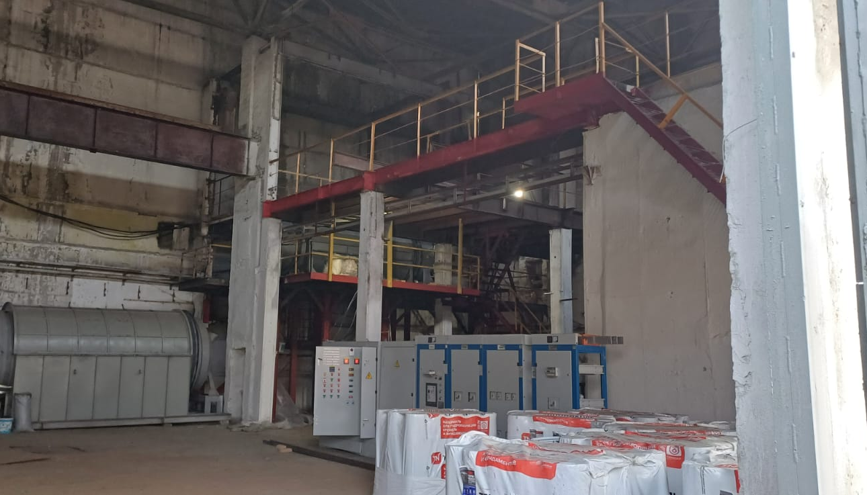
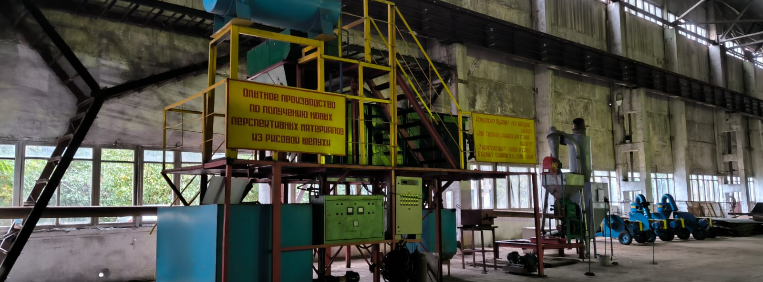

Slide 10
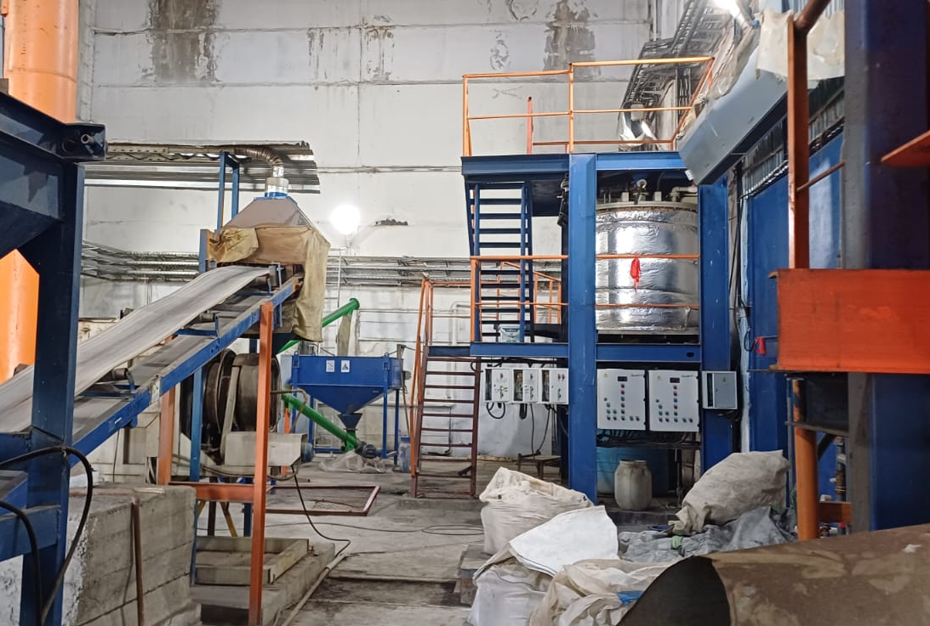
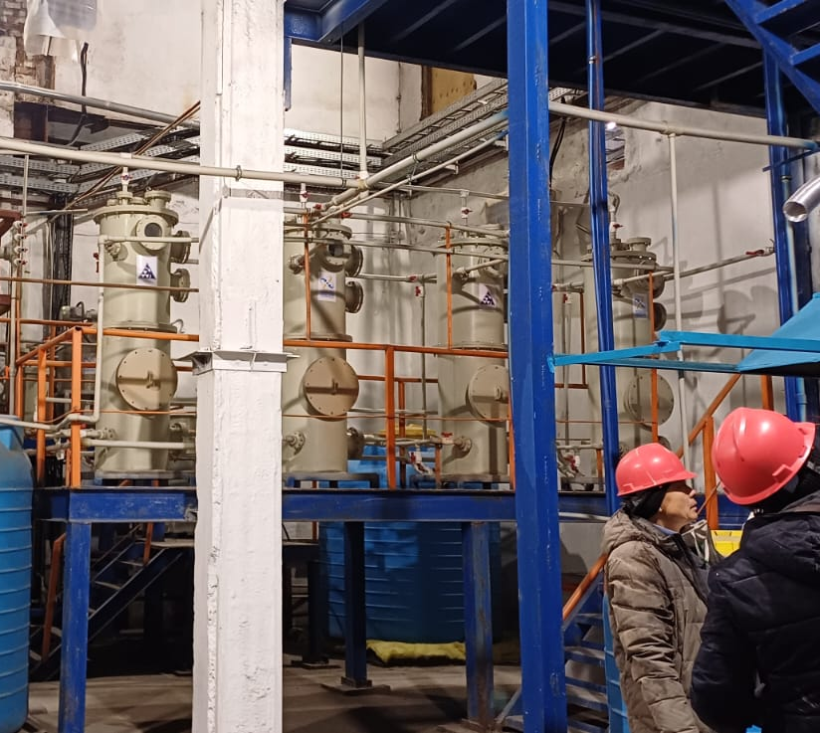
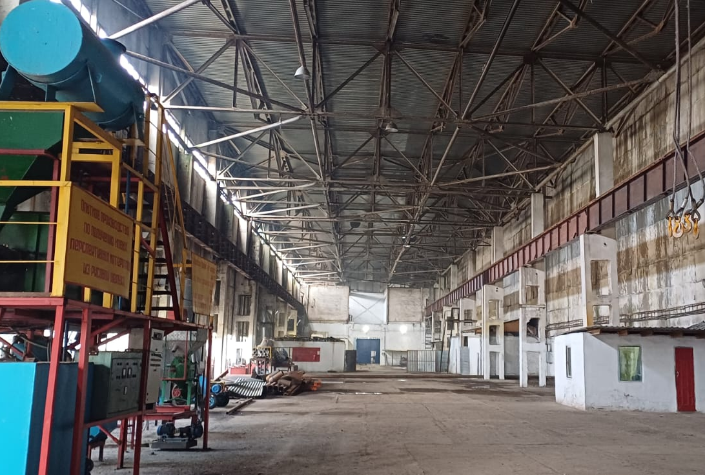

Slide 11
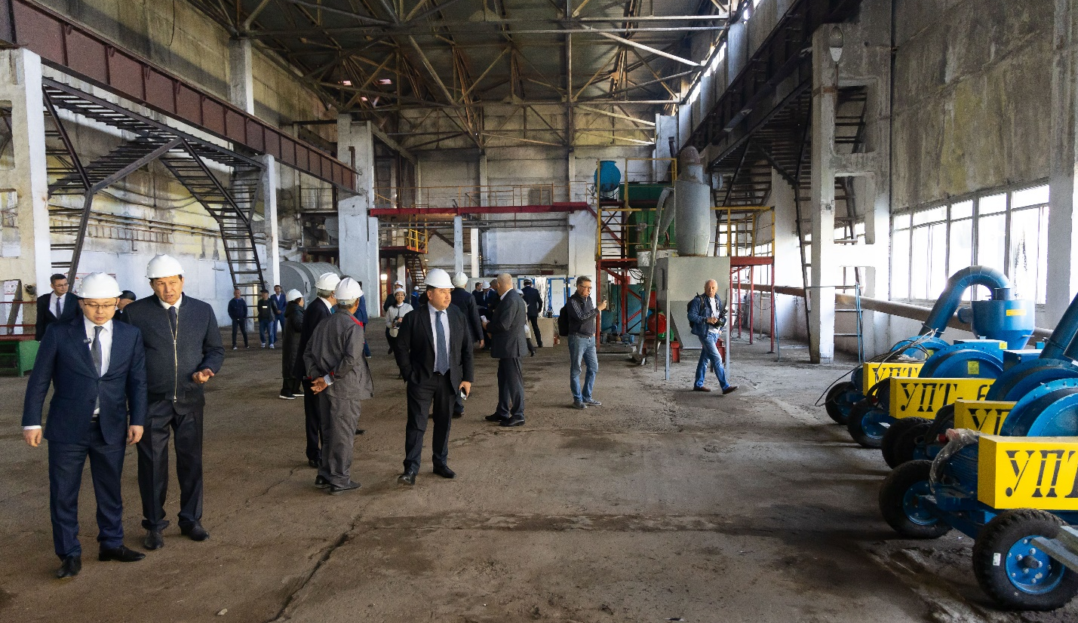
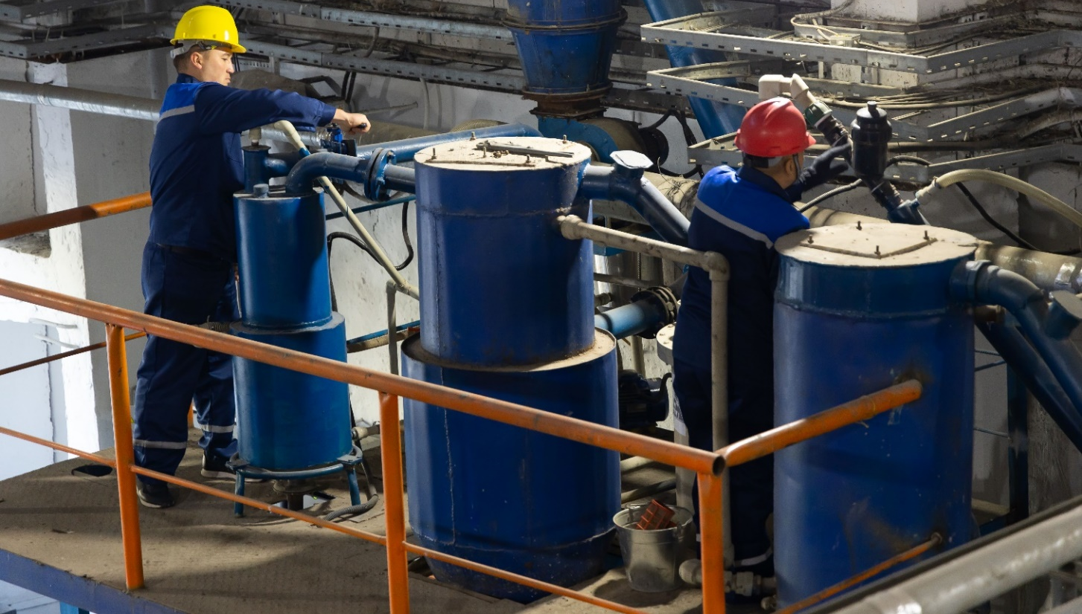
ERC prospects
Collaborative activities at the ERC provide opportunities to:
Develop businesses utilizing untapped mineral deposits.
Create new enterprises focused on innovative industrial processes.
Produce experimental batches of new products based on scientific and technical developments.
Involve R&D teams and individual researchers in commercial applications.

Slide 12



Republican State Enterprise “National Center for Complex Processing of Raw Materials”
Contact Details
Republic of Kazakhstan, 050036
67 Zhandosov st., Almaty
Phone Numbers:
+7 (727) 259 00 70
+7 (701) 721 86 86
+7 (707) 141 42 41
+7 (701) 757 79 98
E-mail: nc@cmrp.kz
Website: cmrp.kz facebook.com/nckpms instagram.com/cmrp.kz

